Slide 1
Database Models

Slide 2
Agenda
Database models
Introduction to types of DBMSs (OLTP, OLAP, NOSQL etc.)
Two and Three tier Architectures
3 schema architecture (Logical, Conceptual and Physical)
Classifications of DBMS
Variations of DBMS
Cost Considerations
Database Models
Hierarchical
Network
Relational
OO data models

Slide 3
Online Transaction Processing System (OLTP)
OLTP System deals with operational data. Operational data are those data involved in the operation of a particular system.
Example: In a banking System, you withdraw amount from your account. Then Account Number, Withdrawal amount, Available Amount, Balance Amount, Transaction Number etc. are operational data elements.
Operational Data
Operational data are usually of local relevance
Frequent Updates
Normalized Tables
Point Query
In an OLTP system data are frequently updated and queried. So quick response to a request is highly expected. Since the OLTP systems invlove large number of update queries, the database tables are optimized for write operations.
To prevent data redundancy and to prevent update anomalies the database tables are normalized.Set of tables that are normalized are fragmented. Normalization makes the write operation in the database tables more efficient.

Slide 4
Online Transaction Processing System (OLTP)
Operational data are usually of local relevance. It involves Queries accessing individual tuple(individual record).These type of queries are termed as point queries.
Examples for OLTP Queries:
What is the Salary of Mr. John?
Withdraw Money from Bank Account : It perform update operation if money is withdrawn from account.
What is the address and email id of the person who is the head of maths department?

Slide 5
Online Analytical Processing (OLAP)
OLAP deals with Historical Data or Archival Data. Historical data are those data that are archived over a long period of time. Data from OLTP are collected over a period of time and store it in a very large database called Data warehouse. The Data warehouses are highly optimized for read (SELECT) operation.
Example: If we collect last 10 years data about flight reservation, The data can give us many meaningful information such as the trends in reservation. This may give useful information like peak time of travel, what kinds of people are traveling in various classes (Economy/Business)etc.
Analytical Query: Online Analytical Processing (OLAP) queries are of analytical form. Query need to access large amount of data and require huge number of aggregations. It access large number of records from database tables and perform the required operation based on this.
Historical Data or Archival Data
Infrequent updates
Analytical queries require huge number of aggregations
Integrated data set with a global relevance

Slide 6
Online Analytical Processing (OLAP)
Updates are very rare in a Data warehouse. OLAP queries will give aggregated information about the things happened in the past over a period of time and this will help the management in strategic decision making. Hence OLAP Queries are of having significant importance in strategic decision making.
Examples for OLAP Queries
How is the profit changing over the years across different regions ?
Is it financially viable continue the production unit at location X?

Slide 7
NoSQL
NoSQL.. Means Not Only SQL, hence the term NoSQL
It is a term used to refer to a class of database systems that differ from the traditional relational database management systems (RDBMS) in many ways
Implies not accessed by SQL
More specifically not RDBMS or more accurately not relational
They are distributed, can scale horizontally and can handle data volumes of the order of several terabytes or petabytes, with low latency
They have less rigid schemas than a traditional RDBMS
They have weaker transactional guarantees
As suggested by the name, these databases do not support SQL
Many NoSQL databases model data as row with column families, key value pairs or documents

Slide 8
Consider NoSQL when…
Your data has grown so large that it can no longer be handled without partitioning
Your RDBMS can no longer handle the load
You need very high write performance and low latency reads
Your data is not very structured
You can have no single point of failure
You can tolerate some data inconsistency

Slide 9
Two and Three Tier Database Architecture
Database architecture is logically divided into two types.
Logical two-tier Client / Server architecture
Logical three-tier Client / Server architecture
Two-tier Client / Server architecture is used for User Interface program and Application Programs that runs on client side. An interface called ODBC(Open Database Connectivity) provides an API that allows client side program to call the DBMS.
Most DBMS vendors provide ODBC drivers. A client program may connect to several DBMS's.
In this architecture some variation of client is also possible for example in some DBMS's more functionality is transferred to the client including data dictionary, optimization etc. Such clients are called Data server.

Slide 10
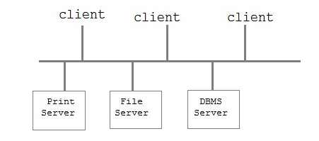
Two Tier Database Architecture Diagram
Two Tier Architecture

Slide 11
Three-tier Client / Server Architecture
Three-tier Client / Server database architecture is commonly used architecture for web applications.
Intermediate layer called Application server or Web Server stores the web connectivity software and the business logic(constraints) part of application used to access the right amount of data from the database server.
This layer acts like medium for sending partially processed data between the database server and the client.

Slide 12
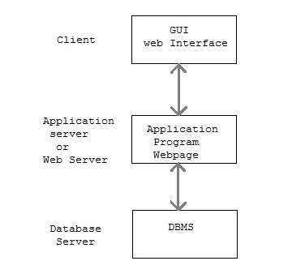
Three-tier Client / Server Architecture Diagram
Three-tier Client / Server Architecture
Three Tier Architecture

Slide 13
3 schema Architecture
Proposed to support DBMS characteristics of:
Program-data independence.
Support of multiple views of the data.
Not explicitly used in commercial DBMS products, but has been useful in explaining database system organization

Slide 14
3 schema Architecture Contd..
Defines DBMS schemas at three levels:
Internal schema at the internal level to describe physical storage structures and access paths (e.g. indexes).
Typically uses a physical data model.
Conceptual schema at the conceptual level to describe the structure and constraints for the whole database for a community of users.
uses a conceptual or an implementation data model.
External schemas at the external level to describe the various user views.
Usually uses the same data model as the conceptual schema.

Slide 15
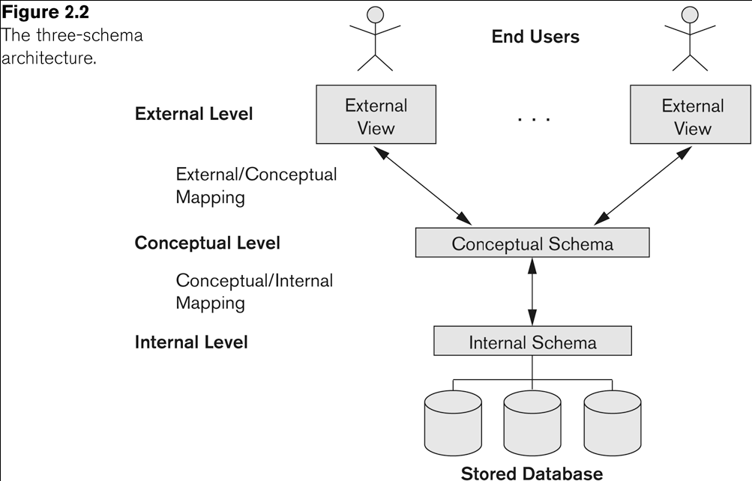
3 schema Architecture Contd..

Slide 16
3 schema Architecture Contd..
Mappings among schema levels are needed to transform requests and data.
Programs refer to an external schema, and are mapped by the DBMS to the internal schema for execution.
Data extracted from the internal DBMS level is reformatted to match the user’s external view (e.g. formatting the results of an SQL query for display in a Web page)

Slide 17
Data Independence
Logical Data Independence:
The capacity to change the conceptual schema without having to change the external schemas and their associated application programs.
Physical Data Independence:
The capacity to change the internal schema without having to change the conceptual schema.
For example, the internal schema may be changed when certain file structures are reorganized or new indexes are created to improve database performance

Slide 18
Standalone Database
A standalone database is usually a single user or personal database used by individuals / small organizations to store and process their data.
These databases have limited size and restricted features unlike large and multiuser databases
Examples of such databases include Microsoft Access, SQLite etc.

Slide 19
Multiuser Databases
Multiuser databases are large databases that run on client-server model
One or more database servers hold a centralized database, that caters to several thousand users concurrently
Users connect to database server using client tools provided by the database vendors or third party applications
These databases are big in size and bring in several features that are useful for variety of database users
Require dedicated database administrators (DBA) who are responsible for maintaining the database taking regular backups, performance tuning and addressing user issues

Slide 20
Distributed Databases
A distributed database is a collection of multiple, logically interrelated database distributed over a computer network.
It is a s/w system that permits the management of the distributed database and the distribution transparent to the users.
It is a database that consists of two or more data files located at different sites on a network because of which, different users can access it without interfering with one another. However, the DBMS must periodically synchronize the scattered database to make sure that they all have consistent data

Slide 21
Internet (web) based database
Internet has proliferated the world and is now accessible everywhere with the help of smartphones. This has prompted use of internet (web) based databases
Such databases allow people to access a centralized database from anywhere by means of a web interface
Advantage of such databases is their wide reach and virtually no expense on client s/w, as they interface via web browsers

Slide 22
Grid Database
Grid computing is the on-demand sharing of computing resources with in a tightly-coupled network.
Grid computing performs a “virtualization” of distributed computing resources and allows for the automated allocating of resources as system demand changes. Each server is independent, yet ready to participate in a variety of processing requests from many types of applications.
Grid computing turns computing into a utility, where users don't care where the data resides, or what computer processes a request. Users request information or computation and have it delivered - as much as they want, whenever they want.
A grid based database product like Oracle, allows you to set up a database on grid.
Oracle Database with Real Application Clusters and Oracle Clusterware provide the infrastructure for your database grid. Automatic Storage Management provides the infrastructure for a storage grid. Oracle Enterprise Manager Grid Control provides you with holistic management of your grid.

Slide 23
Database Models
Definition: collection of logical constructs used to represent data structure and relationships within the database.
Conceptual models: logical nature of data representation; if emphasizes on what entity is presented; it is used for database design as blueprint
Implementation models: emphasis on how the data are represented in the database
Notes:
Database models can be grouped into two categories : Conceptual models and implementation models. Conceptual model is concerned with what is represented in the database rather than how it is represented. Conceptual models include Entity-Relationship model and the Object-Oriented model

Slide 24
Database Models
Conceptual models include
Entity-relationship database model (ERDBM)
Object-oriented database model (OODBM)
Implementation models include
Hierarchical database model (HDBM)
Network database model (NDBM)
Relational database model (RDBM)
Object-oriented database model (OODBM)

Slide 25
Outline
Hierarchical (tree)
Data is organized top-down
Network
Owner-membership relationship
A member can have many owners
Relational
Uses tabular format with 2-dimensional tables (relations)
Relations resemble files

Slide 26
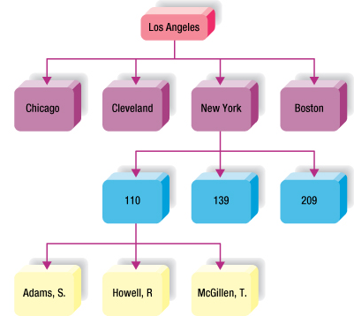
Hierarchical Database
Logically represented by an upside down tree.
Each parent can have many children (segment linkage)
Each child has only one parent
Notes:
Fields or records structured in nodes; viewed as branches of an upside-down tree
Each item is subordinate to its parent node; only one parent per node; parent can have several child nodes
The subordinate item is the child node to the parent
If parent node is deleted, all the child nodes deleted
New parent node must be created before adding new child node
Limited by rigid structure
No direct relationships between child nodes between child nodes

Slide 27
Hierarchical Database Model : Advantages
Conceptual simplicity: relationship between layers is logically simple; design process is simple
Database security: enforced uniformly through the system
Data integrity
Data independence
Efficiency in 1:M relationships and when uses require large numbers of transactions
Dominant in 1970s , when we used mainframe system with large databases

Slide 28
Hierarchical Database Model
Disadvantages:
Complex implementation: physical data storage characteristics; database design is complicated
Difficult to manage and lack of standards
Lacks structural independence
Applications programming and use complexity (pointer based)
Implementation limitations, i.e. especially it only handle 1:M type of model
Little scope for Query Optimization

Slide 29
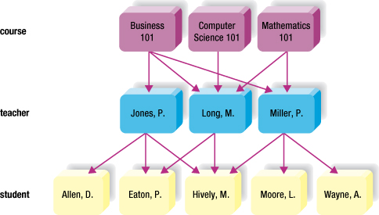
Network Database Model
Hierarchical like node arrangement
Child node can have more than 1 parent
Many-to-many relationships
Access via multiple pathways
Flexible, powerful
Notes:
Also has hierarchical node arrangement -- but here child nodes may have more than one parent node.
This makes many-to-many relationships possible.
The interconnected design allows for access via multiple pathways; i.e., more flexible and powerful.

Slide 30
Network Database Model
Advantages
Conceptual simplicity, just lime HDM
Handles more relationship types (but all 1:M relationship)
Data access flexibility
Promotes database integrity
Data independence
Conformance to standards
Disadvantages
System complexity
Lack of structural independence

Slide 31
Relational Model
What is Relational Model ?
Who developed ?
When it was developed ?
What type of structure it follows ?
What are its advantages and disadvantages ?

Slide 32
The Relational Model
Was introduced in 1970 by Dr. E. F. Codd (of IBM)
Commercial relational databases began to appear in the 1980s
Today relational databases have become the dominant technology for database management
Notes:
Some examples of databases
Banking system (ODBS)
Factory shop floor system
Airline reservation system
Credit checking system
Air traffic control system
Library and information system (IDBS)
Marketing information system
Police detective system

Slide 33
The Relational Model
Data is represented in the form of tables, and the model has 3 components
Data structure – data are organised in the form of tables with rows and columns
Data manipulation – powerful operations (using the SQL language) are used to manipulate data stored in the relations
Data integrity – facilities are included to specify business rules that maintain the integrity of data when they are manipulated

Slide 34
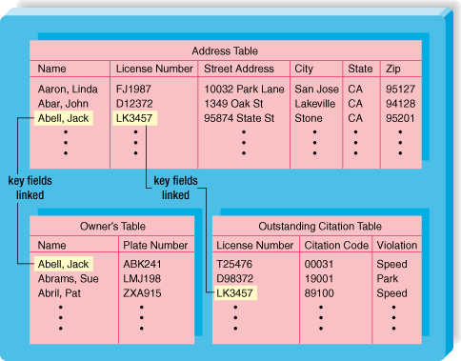
Relational Database
Data stored in tables
Rows and columns
Record = row
Field = column
Most flexible
Tables related via common data item
Easy to use
Notes:
No pre-determined access paths
Data stored in a collection of columns and rows called a table, or a relation
Tables may be logically linked via a key field containing common data
Most valuable feature of relational database: simplicity
Easy to add, delete and modify the data
Easy to add to, delete and modify table structures
Common for microcomputers:
Access
Paradox
dBASE
R:Base

Slide 35
Relational Definitions
A relation is a named, two-dimensional table of data
Every relation has a unique name, and consists of a set of named columns and an arbitrary number of unnamed rows
An attribute is a named column of a relation, and every attribute value is atomic.
Every row is unique, and corresponds to a record that contains data attributes for a single entity.
The order of the columns is irrelevant.
The order of the rows is irrelevant.

Slide 36
Relational Database Model : Advantages
Structural independence: data access path is irrelevant to database design; change structure will not affect the database
Improved conceptual simplicity
Easier database design, implementation, management, and use
Ad hoc query capability with SQL (4GL is added)
Powerful database management system

Slide 37
Relational Database Model : Disadvantages
Substantial hardware and system software overhead
Poor design and implementation is made easy
May promote “islands of information” problems

Slide 38
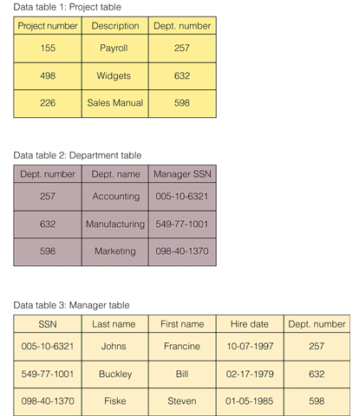
Relational Database Model

Slide 39
Object-oriented Data Model
Several models have been proposed for implementing in a database system.
One set comprises models of persistent O-O Programming Languages such as C++ (e.g., in OBJECTSTORE or VERSANT), and Smalltalk (e.g., in GEMSTONE).
Additionally, systems like O2, ORION (at MCC – then ITASCA), IRIS (at H.P.- used in Open OODB). Object Database Standard: ODMG-93, ODMG-version 2.0, ODMG-version 3.0.

Slide 40
Object-Relational Model
Most Recent Trend. Started with Informix Universal Server.
Relational systems incorporate concepts from object databases leading to object-relational.
Exemplified in the latest versions of Oracle-10i,DB2, and SQL Server and other DBMSs.
Standards included in SQL-99 and expected to be enhanced in future SQL standards.

Slide 41
Thank you
Visit us at www.techmahindra.com
Disclaimer
Tech Mahindra Limited, herein referred to as TechM provide a wide array of presentations and reports, with the contributions of various professionals. These presentations and reports are for informational purposes and private circulation only and do not constitute an offer to buy or sell any securities mentioned therein. They do not purport to be a complete description of the markets conditions or developments referred to in the material. While utmost care has been taken in preparing the above, we claim no responsibility for their accuracy. We shall not be liable for any direct or indirect losses arising from the use thereof and the viewers are requested to use the information contained herein at their own risk. These presentations and reports should not be reproduced, re-circulated, published in any media, website or otherwise, in any form or manner, in part or as a whole, without the express consent in writing of TechM or its subsidiaries. Any unauthorized use, disclosure or public dissemination of information contained herein is prohibited. Unless specifically noted, TechM is not responsible for the content of these presentations and/or the opinions of the presenters. Individual situations and local practices and standards may vary, so viewers and others utilizing information contained within a presentation are free to adopt differing standards and approaches as they see fit. You may not repackage or sell the presentation. Products and names mentioned in materials or presentations are the property of their respective owners and the mention of them does not constitute an endorsement by TechM. Information contained in a presentation hosted or promoted by TechM is provided “as is” without warranty of any kind, either expressed or implied, including any warranty of merchantability or fitness for a particular purpose. TechM assumes no liability or responsibility for the contents of a presentation or the opinions expressed by the presenters. All expressions of opinion are subject to change without notice.

